Slide 1
The 5th group
Group members:
刘平花、陈秋君、余健龙、李标文、林济勇、刘昆武、周展莜

Slide 2
Content
Preview Pi zero – Pi 4B+
Intro Pi 4B+ the source of Raspi
What's the Raspberry Pi Foundation?
What can you do with a Raspberry Pi?(main)
Raspberry Pi OS

Slide 3
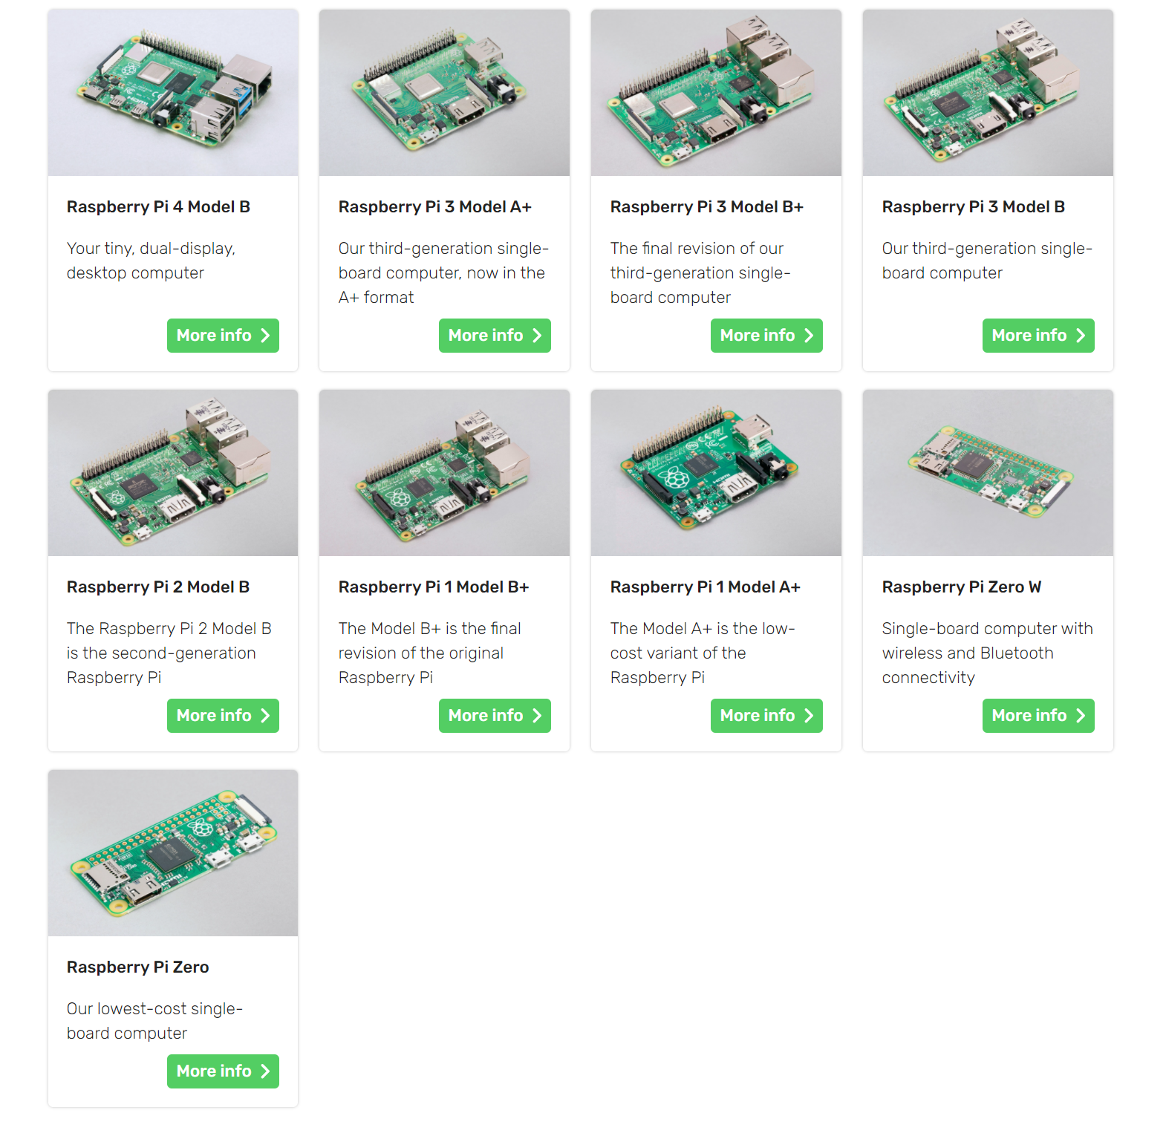

Slide 6
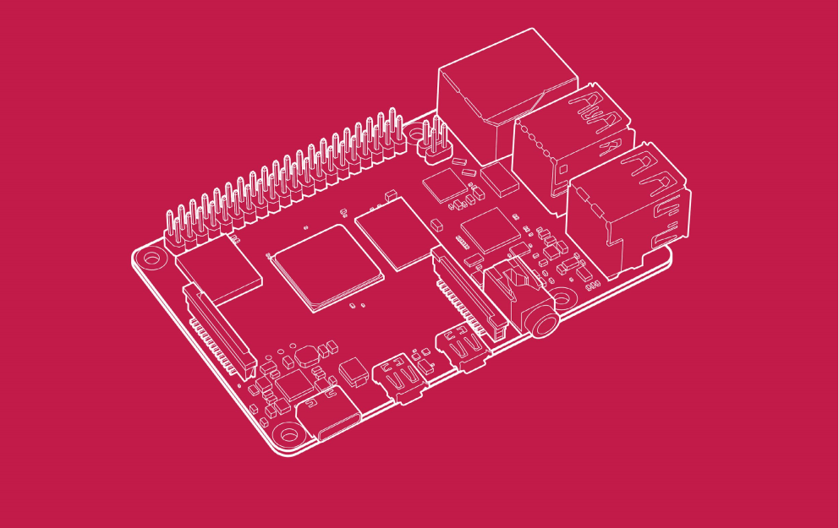
Introduction to Raspberry Pi 4 Computer Model B

Slide 7
Firstly,Talk about the Source of Raspberry Pi
Raspberry Pi is the name of a series of single-board computers made by the Raspberry Pi Foundation, a UK charity that aims to educate people in computing and create easier access to computing education.
The Raspberry Pi launched in 2012, and there have been several iterations and variations released since then. The original Pi had a single-core 700MHz CPU and just 256MB RAM, and the latest model has a quad-core CPU clocking in at over 1.5GHz, and 4GB RAM. The price point for Raspberry Pi has always been under $100 (usually around $35 USD), most notably the Pi Zero, which costs just $5.
All over the world, people use the Raspberry Pi to learn programming skills, build hardware projects, do home automation, implement Kubernetes clusters and Edge computing, and even use them in industrial applications.
The Raspberry Pi is a very cheap computer that runs Linux, but it also provides a set of GPIO (general purpose input/output) pins, allowing you to control electronic components for physical computing and explore the Internet of Things (IoT).
Ref:https://opensource.com/resources/raspberry-pi

Slide 8
What's the Raspberry Pi Foundation?
The Raspberry Pi Foundation works to put the power of computing and digital making into the hands of people all over the world. It does this by providing low-cost, high-performance computers that people use to learn, solve problems, and have fun. It provides outreach and education to help more people access computing and digital making—it develops free resources to help people learn about computing and making things with computers and also trains educators who can guide other people to learn.
Code Club and CoderDojo are part of the Raspberry Pi Foundation, although these programs are platform-independent (they're not tied to Raspberry Pi hardware). The Raspberry Pi Foundation promotes these clubs and helps grow the network around the world in order to ensure every child has access to learning about computing. Similarly, Raspberry Jams are Raspberry Pi-focused events for people of all ages to come together to learn about Raspberry Pi and share ideas and projects.
Ref:https://opensource.com/resources/raspberry-pi

Slide 9
What can you do with a Raspberry Pi?(main)
Some people buy a Raspberry Pi to learn to code, and people who can already code use the Pi to learn to code electronics for physical projects. The Raspberry Pi can open opportunities for you to create your own home automation projects, which is popular among people in the open source community because it puts you in control, rather than using a proprietary closed system.

Slide 10
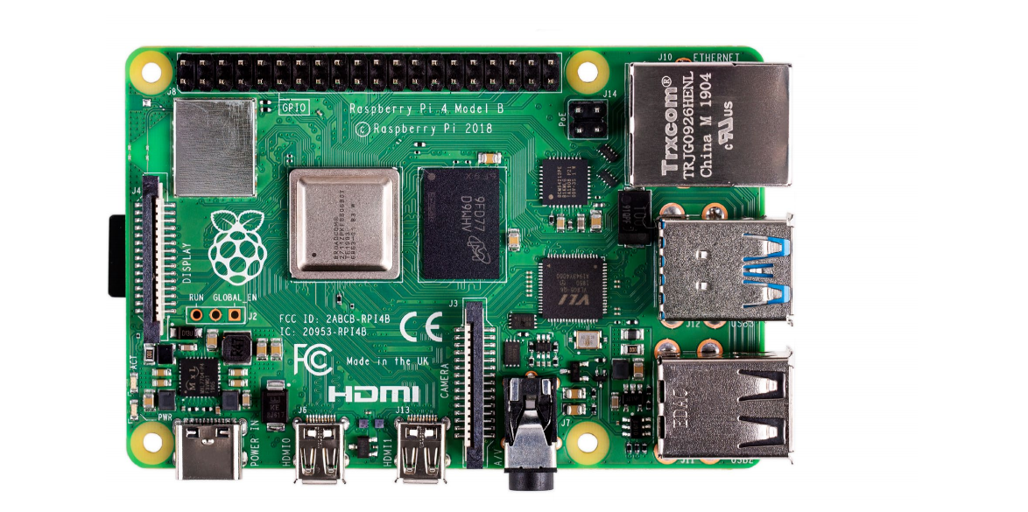
Overview

Slide 11
Raspberry Pi 4 Model B is the latest product in the popular Raspberry Pi range of
computers. It offers ground-breaking increases in processor speed, multimedia
performance, memory, and connectivity compared to the prior-generation
Raspberry Pi 3 Model B+, while retaining backwards compatibility and similar
power consumption. For the end user, Raspberry Pi 4 Model B provides desktop
performance comparable to entry-level x86 PC systems.

Slide 12
This product’s key features include a high-performance 64-bit quad-core
processor, dual-display support at resolutions up to 4K via a pair of
micro-HDMI ports, hardware video decode at up to 4Kp60, up to 8GB of RAM,
dual-band 2.4/5.0 GHz wireless LAN, Bluetooth 5.0, Gigabit Ethernet, USB 3.0,
and PoE capability (via a separate PoE HAT add-on).

Slide 13
The dual-band wireless LAN and Bluetooth have modular compliance certification,
allowing the board to be designed into end products with significantly reduced
compliance testing, improving both cost and time to market.
Ref:Raspberry-Pi-4-Product-Brief.pdf

Slide 14
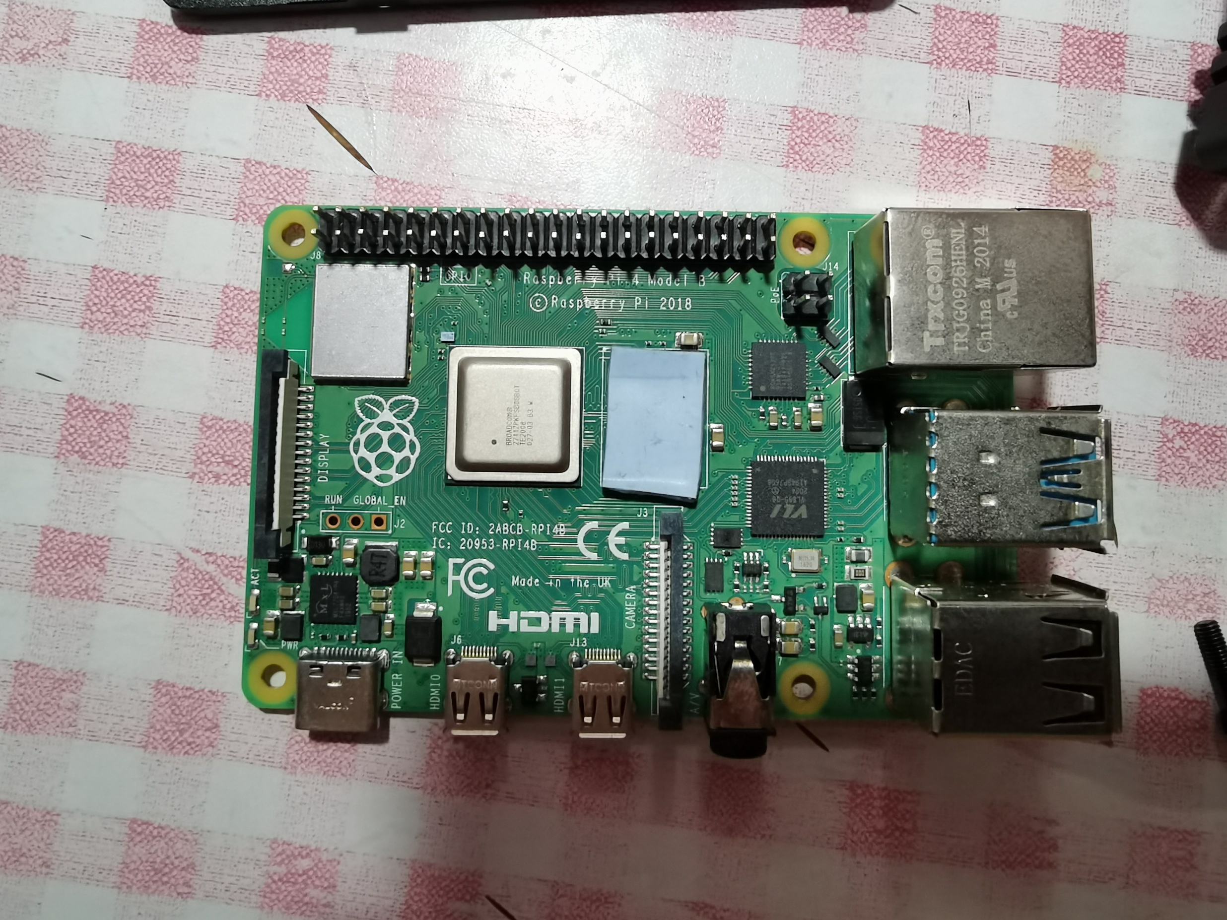
Real Raspberry Pi by Xige

Slide 15
Raspberry Pi OS
Raspberry Pi OS is the recommended operating system for normal use on a Raspberry Pi.
Raspberry Pi OS is a free operating system based on Debian, optimised for the Raspberry Pi hardware. Raspberry Pi OS comes with over 35,000 packages: precompiled software bundled in a nice format for easy installation on your Raspberry Pi.
Raspberry Pi OS is a community project under active development, with an emphasis on improving the stability and performance of as many Debian packages as possible.

